Slide 1

Lab 2.2 Implement Temporal Difference
Notes:
1

Slide 2
Objectives
The 3x3 grid world where the agent starts at position (0, 0) and must navigate to the goal state at position (2, 2). The agent can take four possible actions: up, down, left, and right. Each step incurs a reward of -1 until the goal state is reached, where the reward is +10.
Lab 2.2 implement Temporal Difference
2
Notes:
2

Slide 3
Lab Guide Coding
Using given code
We define a simple grid world environment with a start state, a goal state, and possible actions.
The step function simulates the agent's interaction with the environment by taking an action and returning the next state and reward.
Lab 2.2 implement Temporal Difference
3
Notes:
3

Slide 4
Lab Guide Coding
Using given code
The td_learning function implements Temporal Difference learning to estimate the value function V using TD(0) updates.
We perform TD learning over a specified number of episodes, updating the value function based on observed transitions.
Finally, we print the learned value function, which represents the expected cumulative rewards from each state.
Lab 2.2 implement Temporal Difference
4
Notes:
4

Slide 5
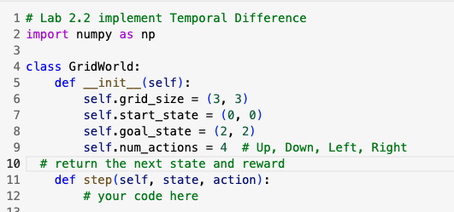
Lab Guide Coding
Lab 2.2 implement Temporal Difference
5
Notes:
5

Slide 6
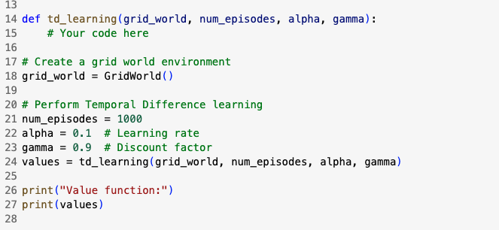
Lab Guide Coding
Lab 2.2 implement Temporal Difference
6
Notes:
6

Slide 7
Q & A
Lab 2.2 implement Temporal Difference
7

